Slide 1
Kardi$ℵ$ální čísla aneb jak spočítat nespočetné
Pavel Gajdoš

Slide 2
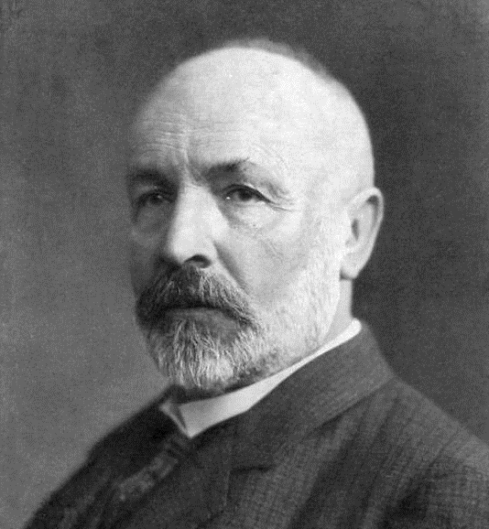
„The essence of mathematics lies in its freedom.“
- Georg Cantor
Zdroj obrázku:
https://i12bent.tumblr.com/post/3622180726/georg-cantor-german-mathematician-and-philosopher

Slide 3
A
b
B
c
b
a
a
d
f
e
|B| = 2
$$∅$$
|A| = 6
|$∅$| = 0

Slide 4
ℕ
ℝ
0
1
$$\frac{1}{2}$$
ℕ
0
1
2
3
4
2
3
4
$$\sqrt{2}$$
5
6
7
5
6
7
$$π$$
…
…
e
9,154489…
|ℕ| =
|ℕ| = $∞$ ???
…
$$∞$$
|ℝ| =
????

Slide 5
Co je to mohutnost?

Slide 6
3
A
b
4
1
c
a
d
5
f
2
e
6
|A| = 6

Slide 7
A
b
3
c
4
a
1
d
5
f
2
e
6
|A| = 6

Slide 8
Množiny, mezi kterými existuje bijekce, mají stejnou mohutnost.
♥
x
♥
?
x
♦
y
♦
y
♣
z
♣

Slide 9
♥
x
♦
y
♣

Slide 10
Konečné mohutnosti
|$∅$| = 0
|{1}| = 1
|{1, 2}| = 2
|{1, 2, 3}| = 3
$⋮$
|{1, …, n}| = n
|{x, 7, ♥}| = ???
x
1
7
2
♥
3
$⇒$ |{x, 7, ♥}| = |{1, 2, 3}| = 3

Slide 11
Nekonečné mohutnosti
|ℕ| =
$$ℵ_{0}$$
ℕ
0
1
2
3
4
5
6
7
…

Slide 12
2ℕ
2
1
ℕ
|2ℕ| = ???
0
0
8
4
6
3
4
2
14
7
12
6
10
…
5
…
n $⟼$ $\frac{n}{2}$
$⇒$ |2ℕ| = |ℕ| = $ℵ_{0}$

Slide 13
|$ℤ$| = ???
$$ℤ$$
…
-2
-1
0
1
2
3
…

Slide 14
ℕ → $ℤ$
0 $⟼$ 0
1 $⟼$ 1
2 $⟼$ -1
3 $⟼$ 2
4 $⟼$ -2
5 $⟼$ 3
6 $⟼$ -3
$⟼$ 4
$⟼$ -4
$⟼$ 5
$⟼$ -5
$⟼$ 6
$⟼$ -6
$⟼$ 7
|$ℤ$| = ???
-7
-6
-5
-4
-3
-2
-1
0
1
2
3
4
5
6
7
8
$⇒$ |$ℤ$| = |ℕ| = $ℵ_{0}$

Slide 15
|$ℚ$| = ???
$$ℚ$$
$$ℤ$$
…
-2
-1
0
1
2
3
$$\frac{1}{2}$$
…
$$\frac{2}{5}$$
$$−\frac{7}{11}$$
$$−\frac{1}{3}$$
…

Slide 16
 | $$\frac{1}{?}$$ | $$\frac{2}{?}$$ | $$\frac{3}{?}$$ | $$\frac{4}{?}$$ | $$\frac{5}{?}$$ | $$\frac{6}{?}$$ | $$\frac{7}{?}$$ | $$\frac{8}{?}$$
$$\frac{?}{1}$$ | $$\frac{1}{1}$$ | $$\frac{2}{1}$$ | $$\frac{3}{1}$$ | $$\frac{4}{1}$$ | $$\frac{5}{1}$$ | $$\frac{6}{1}$$ | $$\frac{7}{1}$$ | $$\frac{8}{1}$$
$$\frac{?}{2}$$ | $$\frac{1}{2}$$ | $$\frac{2}{2}$$ | $$\frac{3}{2}$$ | $$\frac{4}{2}$$ | $$\frac{5}{2}$$ | $$\frac{6}{2}$$ | $$\frac{7}{2}$$ | $$\frac{8}{2}$$
$$\frac{?}{3}$$ | $$\frac{1}{3}$$ | $$\frac{2}{3}$$ | $$\frac{3}{3}$$ | $$\frac{4}{3}$$ | $$\frac{5}{3}$$ | $$\frac{6}{3}$$ | $$\frac{7}{3}$$ | $$\frac{8}{3}$$
$$\frac{?}{4}$$ | $$\frac{1}{4}$$ | $$\frac{2}{4}$$ | $$\frac{3}{4}$$ | $$\frac{4}{4}$$ | $$\frac{5}{4}$$ | $$\frac{6}{4}$$ | $$\frac{7}{4}$$ | $$\frac{8}{4}$$
$$\frac{?}{5}$$ | $$\frac{1}{5}$$ | $$\frac{2}{5}$$ | $$\frac{3}{5}$$ | $$\frac{4}{5}$$ | $$\frac{5}{5}$$ | $$\frac{6}{5}$$ | $$\frac{7}{5}$$ | $$\frac{8}{5}$$
$$\frac{?}{6}$$ | $$\frac{1}{6}$$ | $$\frac{2}{6}$$ | $$\frac{3}{6}$$ | $$\frac{4}{6}$$ | $$\frac{5}{6}$$ | $$\frac{6}{6}$$ | $$\frac{7}{6}$$ | $$\frac{8}{6}$$
$$\frac{?}{7}$$ | $$\frac{1}{7}$$ | $$\frac{2}{7}$$ | $$\frac{3}{7}$$ | $$\frac{4}{7}$$ | $$\frac{5}{7}$$ | $$\frac{6}{7}$$ | $$\frac{7}{7}$$ | $$\frac{8}{7}$$
|$ℚ$| = ???
ℕ → $ℚ^{+}$
0 $⟼$ $\frac{1}{1}$
1 $⟼$ $\frac{2}{1}$
2 $⟼$ $\frac{1}{2}$
3 $⟼$ $\frac{1}{3}$
4 $⟼$ $\frac{3}{1}$
5 $⟼$ $\frac{4}{1}$
6 $⟼$ $\frac{3}{2}$
$⟼$ $\frac{2}{3}$
$⟼$ $\frac{1}{4}$
$⇒$ |$ℚ$| = |ℕ| = $ℵ_{0}$

Slide 17
ℝ
$$ℚ$$
$$ℤ$$
|ℕ| = $ℵ_{0}$
|$ℤ$| = $ℵ_{0}$
|$ℚ$| = $ℵ_{0}$
ℕ
0
7
-3
$\frac{1}{2}$
85
3
$$\sqrt{2}$$
…
-17
-$\frac{3}{4}$
-1
…
$$π$$
2,31
$\frac{653}{27}$
…
e
|$ℝ$| = $ℵ_{0}$ ???
…

Slide 18
ℕ → $ℝ$
0 $⟼$ 76,60716076753673895255657189219437662813640819935375
1 $⟼$ -31,42160363215970931083040069505712613629798668235671
2 $⟼$ -60,57215468657205757040605050716036249357519417699979
3 $⟼$ -2,41209495965108699270262362564030328546815390984459
4 $⟼$ 12,46765281302865044781776915934751409222522259544172
5 $⟼$ 43,43675816892740357184743748907888219177388962608850
6 $⟼$ -26,13379798562092822968239947078351885322543178045770
$⟼$ -78,59178872583729315814761915024158660023749163381556
$⟼$ 84,35190208464112120905370195572179130915480310405046
$⟼$ 93,33131136945607967385430529613563224466595849398293
$⟼$ 18,68409983072722647388952610671792533414316041937962
|$ℝ$| = ???
$⇒$ |$ℝ$| $≠$ $ℵ_{0}$
|$ℝ$| = $𝖈$
712004983704978415216578137559873048675
0,__________________________________________________
7
3
3
1
6
9
0
3
5
5
3

Slide 19
A co dál?

Slide 20
Úloha
Určete kardinalitu intervalu
$$I=(0,1)$$
a dokažte svůj výsledek nalezením vhodné bijekce.
0
1
ℝ

Slide 21
Děkuji za pozornost.

Slide 22
Použité zdroje
MARVAN, Michal. Logika a teorie množin. Informační systém SU [online]. Opava: Fakulta informatiky MU, 2021 [cit. 2023-06-17]. Dostupné z: https://is.slu.cz/el/sumu/leto2021/MU06104/um/teormn.pdf
ZLÁMAL, Vojtěch. Nekonečno v matematice [online]. Olomouc, 2012 [cit. 2023-06-17]. Dostupné z: https://theses.cz/id/wvswut/. Diplomová práce. Univerzita Palackého v Olomouci, Přírodovědecká fakulta. Vedoucí práce Mgr. Michal Botur, Ph.D.
STARÝ, Jan. Úvod do matematické logiky. In: FIT ČVUT Course Pages [online]. 2023, 7. března 2023 [cit. 2023-06-17]. Dostupné z: https://courses.fit.cvut.cz/BI-ALO/matematicka-logika.pdf
Cardinal number. In: Wikipedia: the free encyclopedia [online]. San Francisco (CA): Wikimedia Foundation, 2001-, 9 May 2023 14:06 UTC [cit. 2023-06-17]. Dostupné z: https://en.wikipedia.org/w/index.php?title=Cardinal_number&oldid=1153981627

